Slide 1
PICAT Speech to Text
Presentation by:
Aman Kushwah
Mridul Gupta
Kush Bhagor
Dhananjay Singh

Slide 2
Overview
Speech recognition is a technology that enables a computer to capture the words spoken by a human with a help of microphone. These words are later on recognized by speech recognizer, and in the end, system outputs the recognized words in text form.

Slide 3
Objective
To understand the speech recognition and its fundamentals.
Make this application able to listen to speech
and convert into text and display it.
Its implementation as a desktop Application.

Slide 4
Disadvantages of current S2T softwares/APIs
Lack of accuracy and misinterpretation.
Time costs and productivity.
Accents and speech recognition.
Background noise interference.

Slide 5
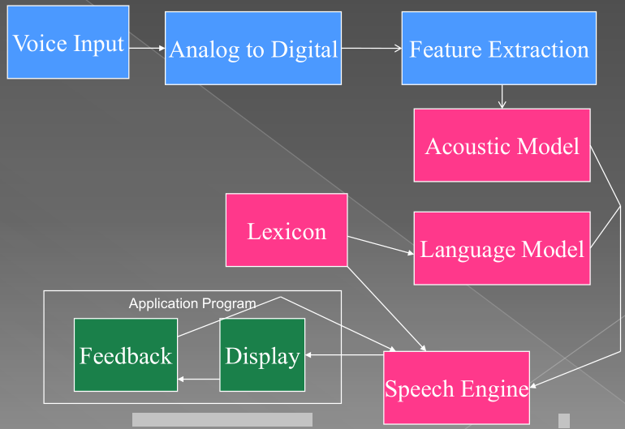
Speech Recognition Process

Slide 6
Voice Input
With the help of microphone audio is input to the system, the pc sound card produces the equivalent digital representation of received audio .

Slide 7
Digitization
The process of converting the analog signal into a digital form is known as digitization, it involves the both sampling and quantization processes. Sampling is converting a continuous signal into discrete signal, while the process of approximating a continuous range of values is known as quantization.

Slide 8
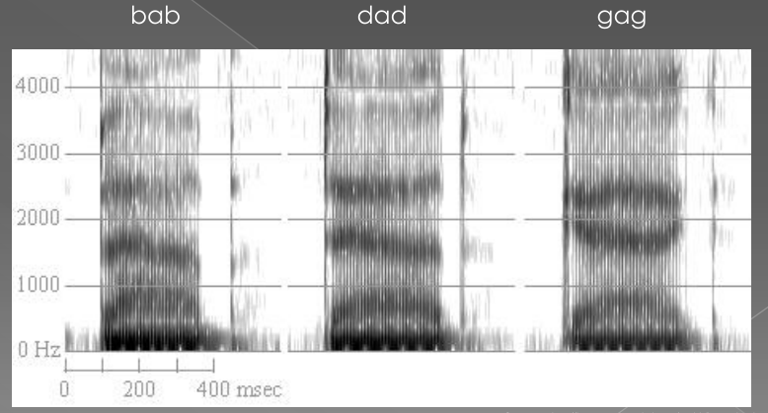
Captures the spectral variations of every phoneme

Slide 9
Acoustic Model
Uses technique called as Hidden Markov Models to capture the temporal variations in speech data
HMM is a statistical Machine Learning Technique
All the models are stored in form of binary files which are then used by decoder for comparing with actual speech data

Slide 10
Phonetic Lexicon
Gives phonetic representation of every word in vocabulary
Can assemble valid words from output produced by acoustic model
चेयरमैन च्ए र् अ म्ऐ न्
आशावादी आ श्आ व्आ द् ई
Main mantra - Smaller the vocabulary size better is the recognition accuracy

Slide 11
Language Model
Language modeling is used in many natural language processing applications such as speech recognition tries to capture the properties of a language and to predict the next word in the speech sequence. The software language model compares the phonemes to words in its built in dictionary.

Slide 12
Application area
Dictation
For specific domains like office documents
System control/navigation
For driving menus, pushbuttons and GUI components
Building hands free GUI interfaces
Commercial/Industrial applications
Limited domain intelligent dialog systems
Telephonic inquiry systems (IVR)
Software for blind people
Entertainment
Operations in computer games
Building chatter bots
Driving intelligent devices
Robots, washing machines, coffee vending machines

Slide 13
Scope
This project has the speech recognizing capabilities which can be used for typing purposes in any of the text editors eg. Notepad.
It can also be embedded in applications like MS-Word as an add-on to do typing.

Slide 14
Thank You…!

